Slide 1
ANNDATA AABHAAR: PROJECT BY AGRO THINKERS, 1. YASHIKA( Team leader) 2.Raghvendra Prasad Srivastava 3. Mahima Singh 4.Abhishek Varun

Slide 2
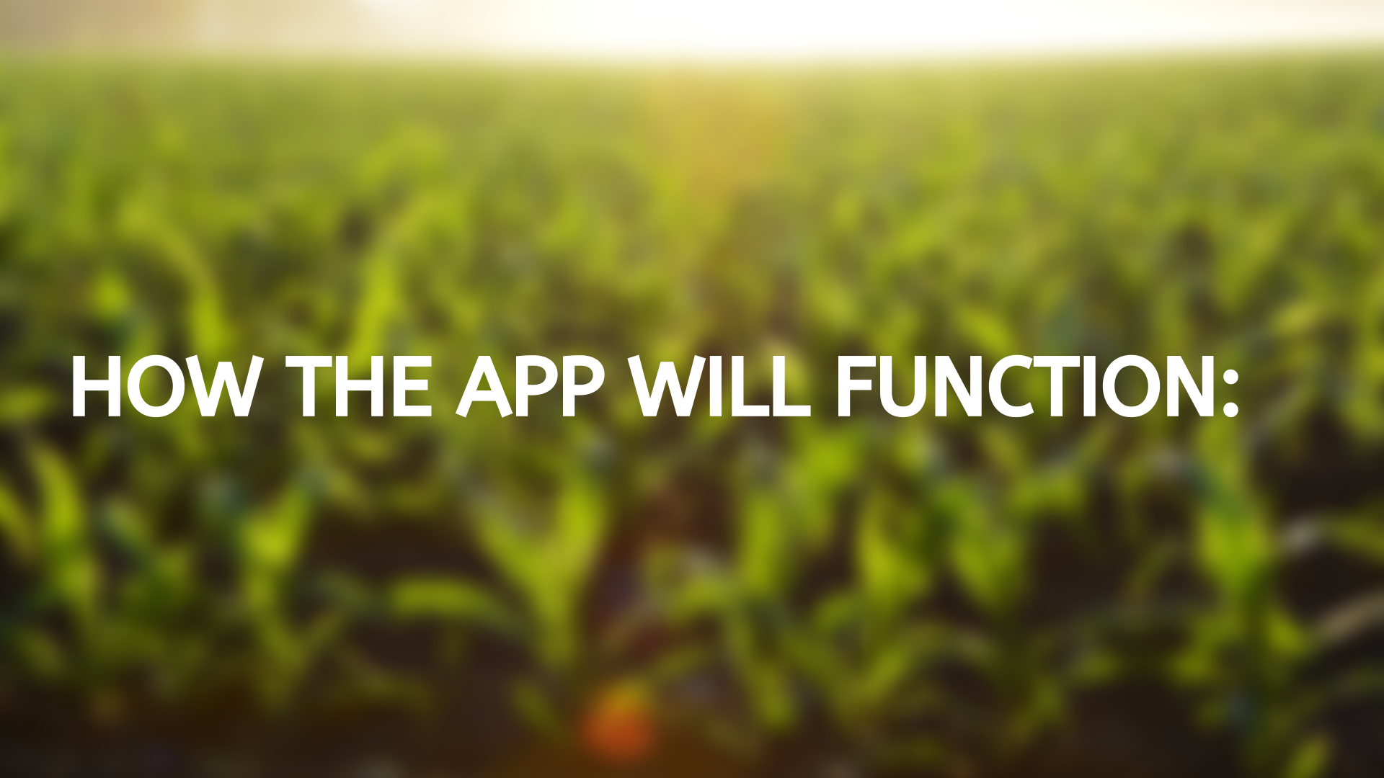

Slide 3
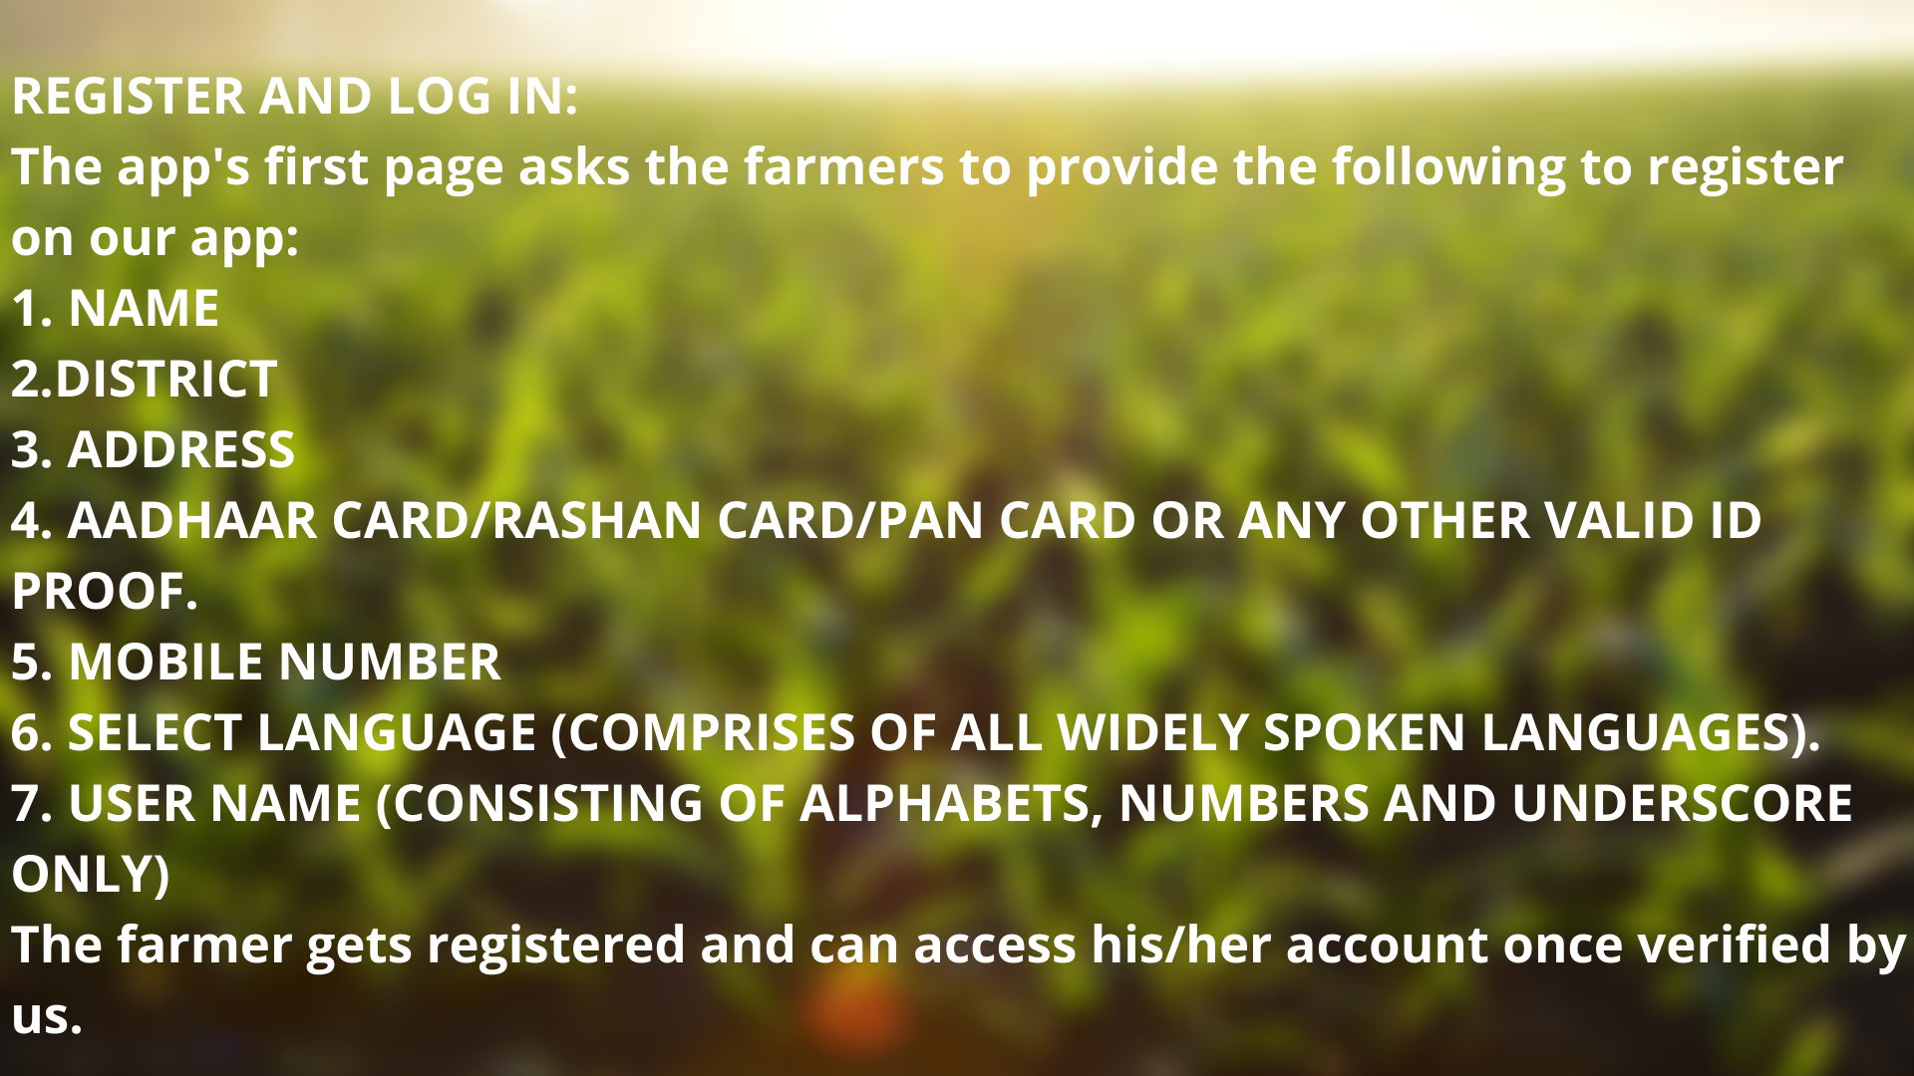

Slide 4
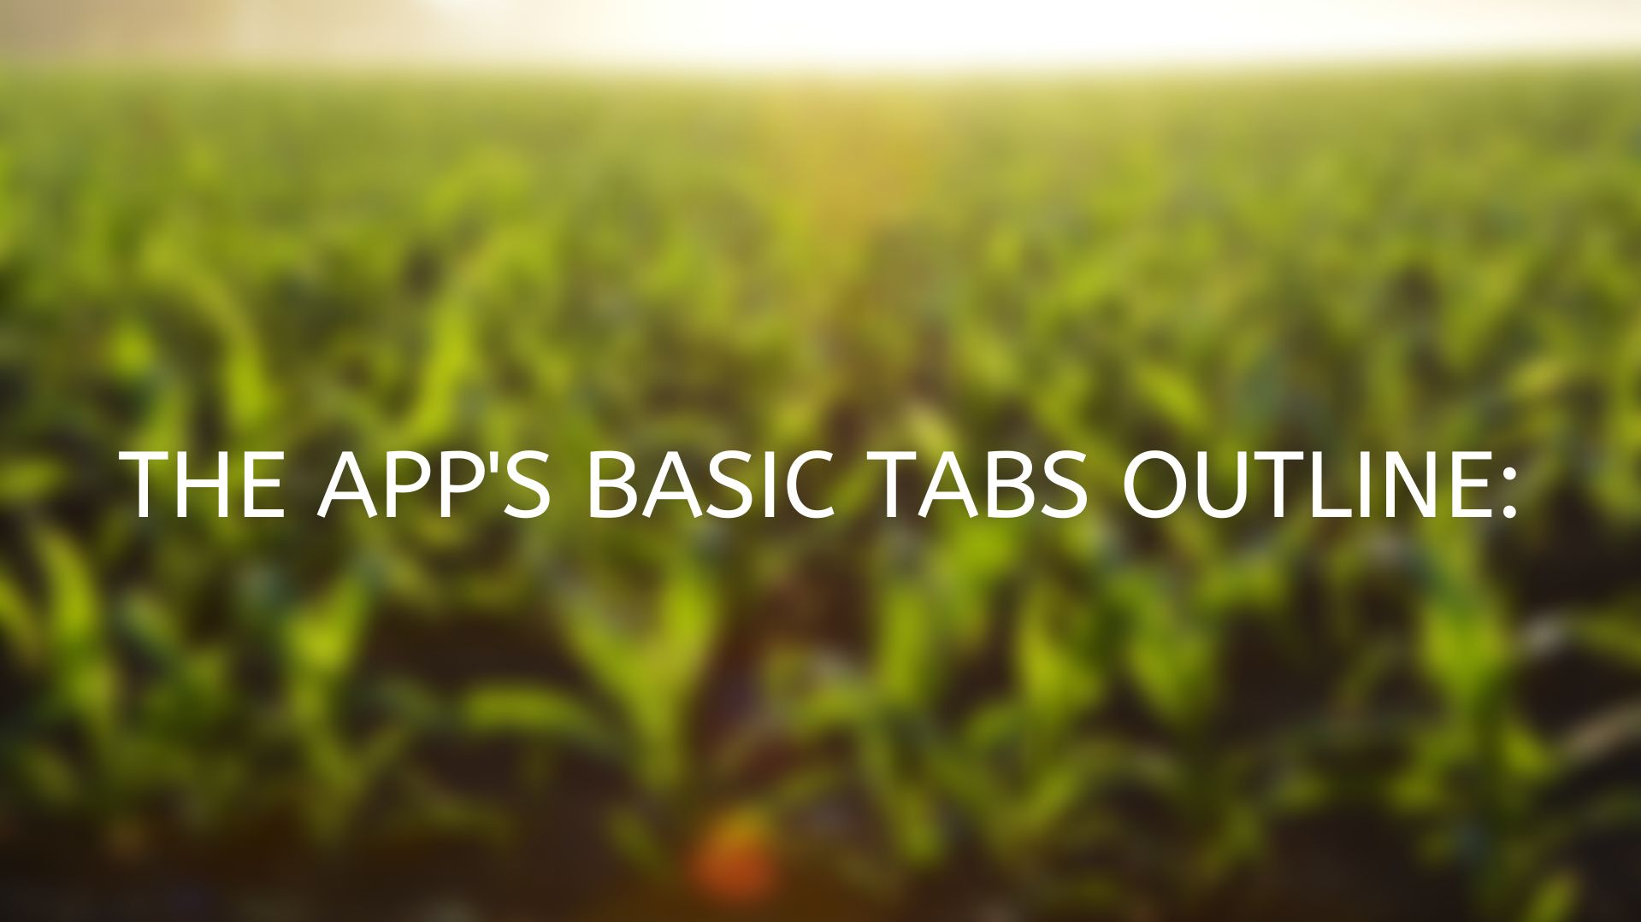

Slide 5
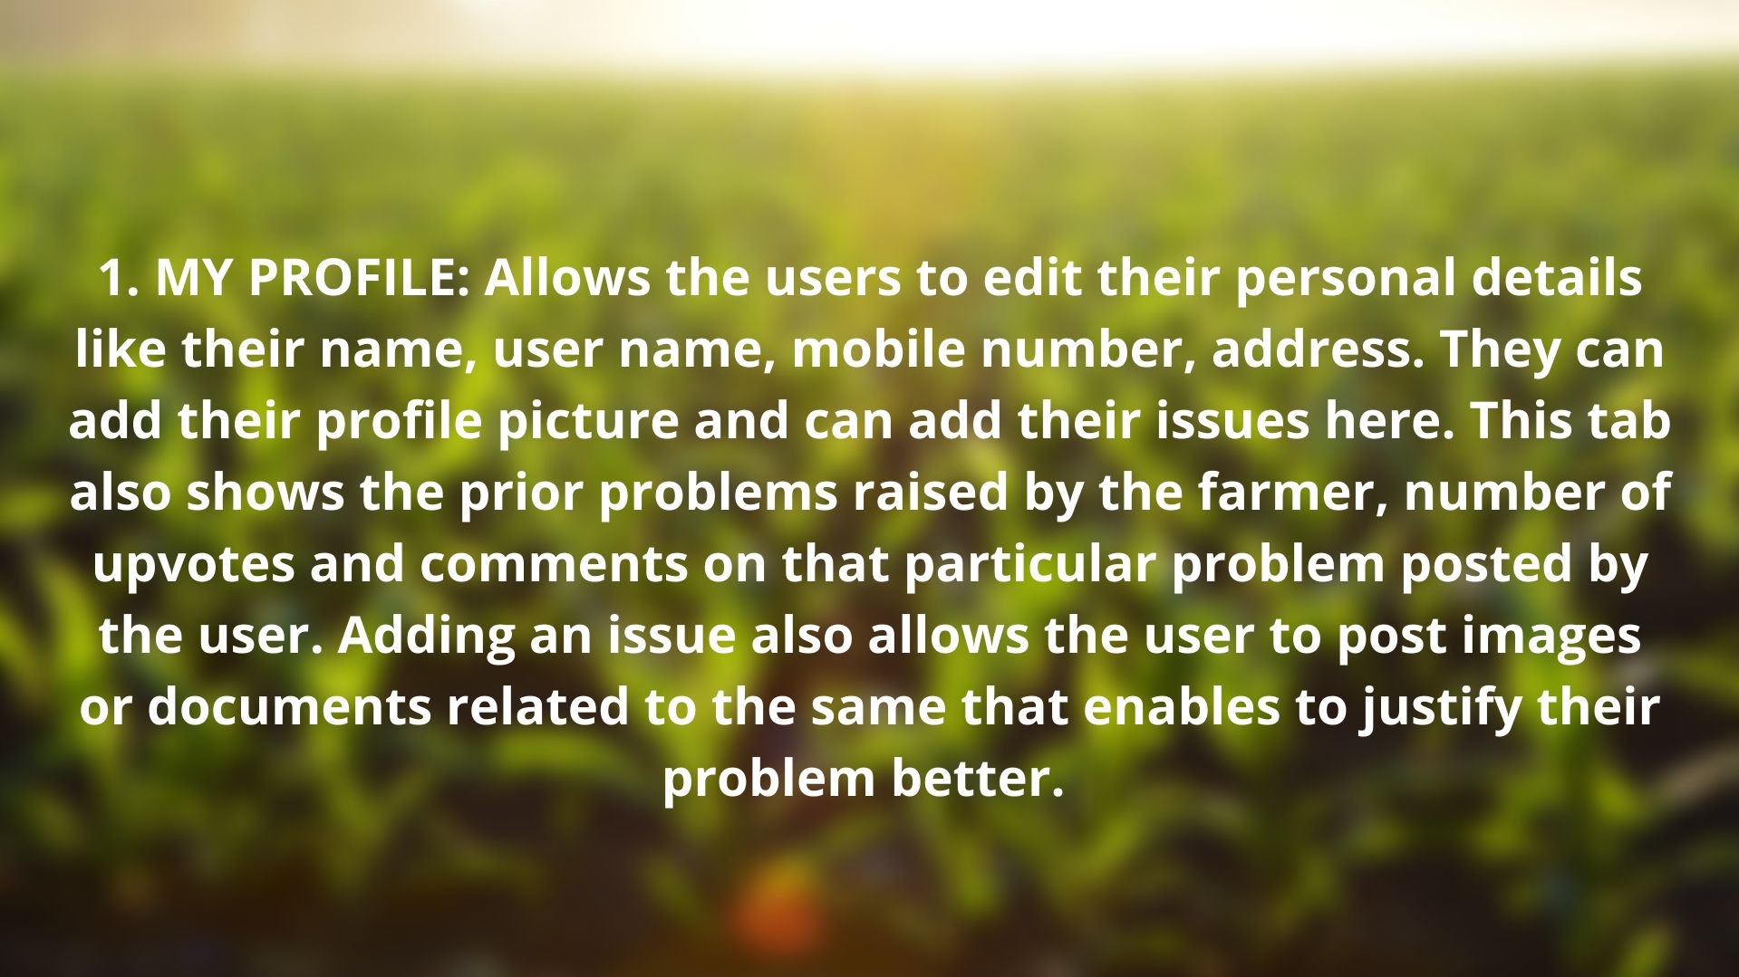

Slide 6
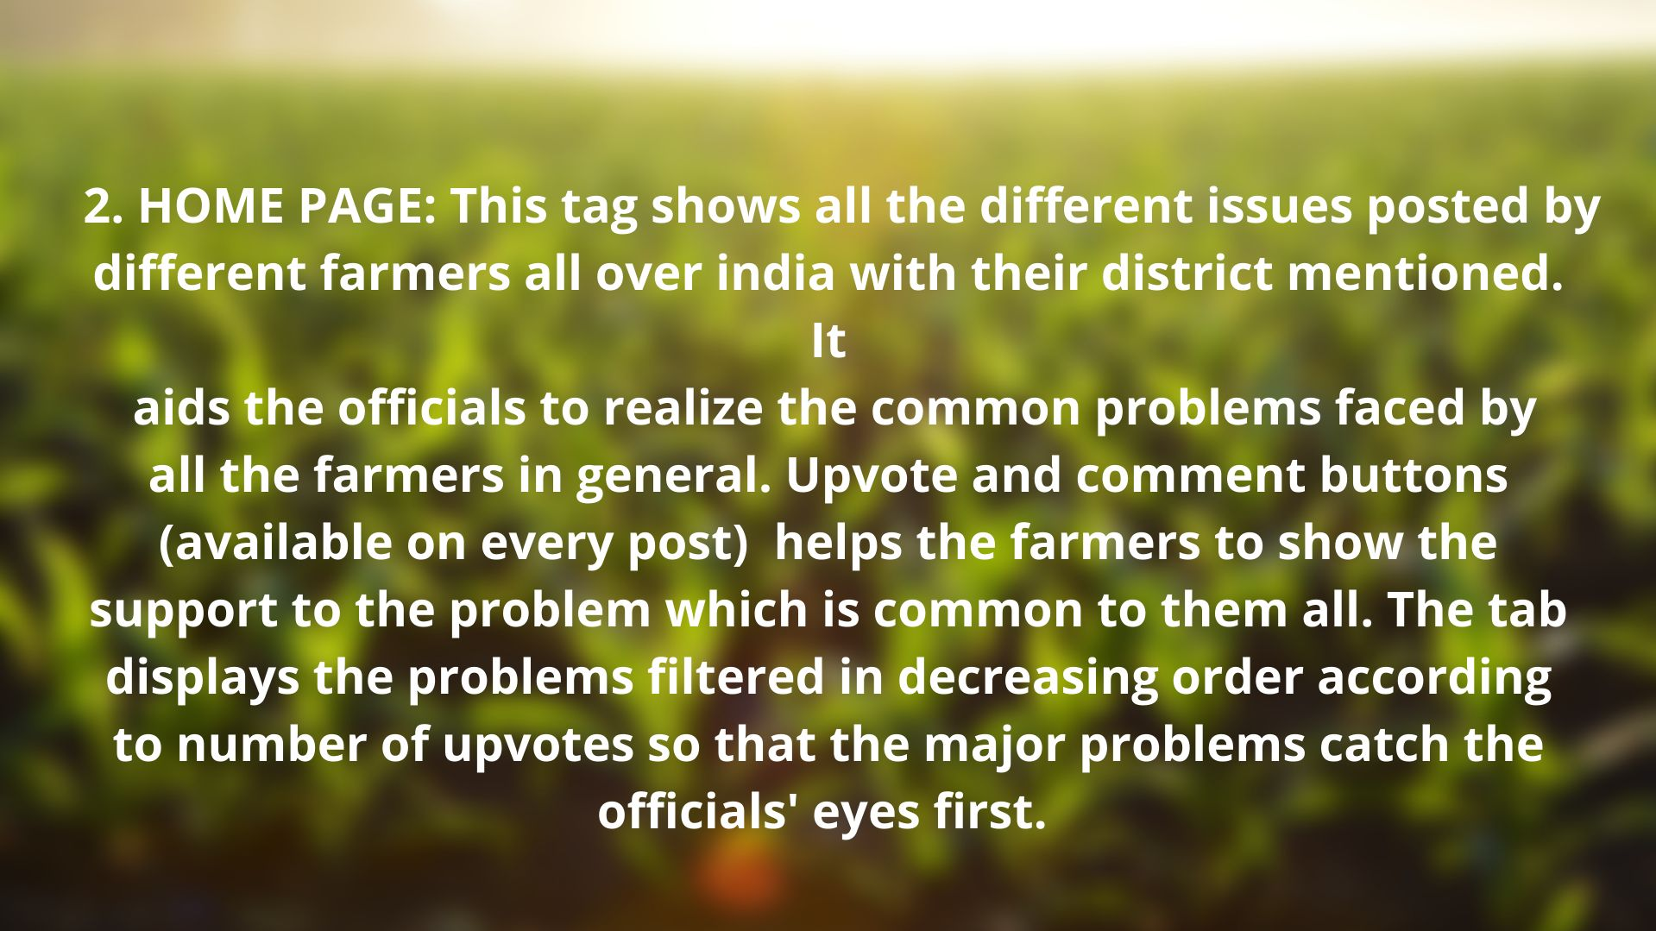

Slide 7
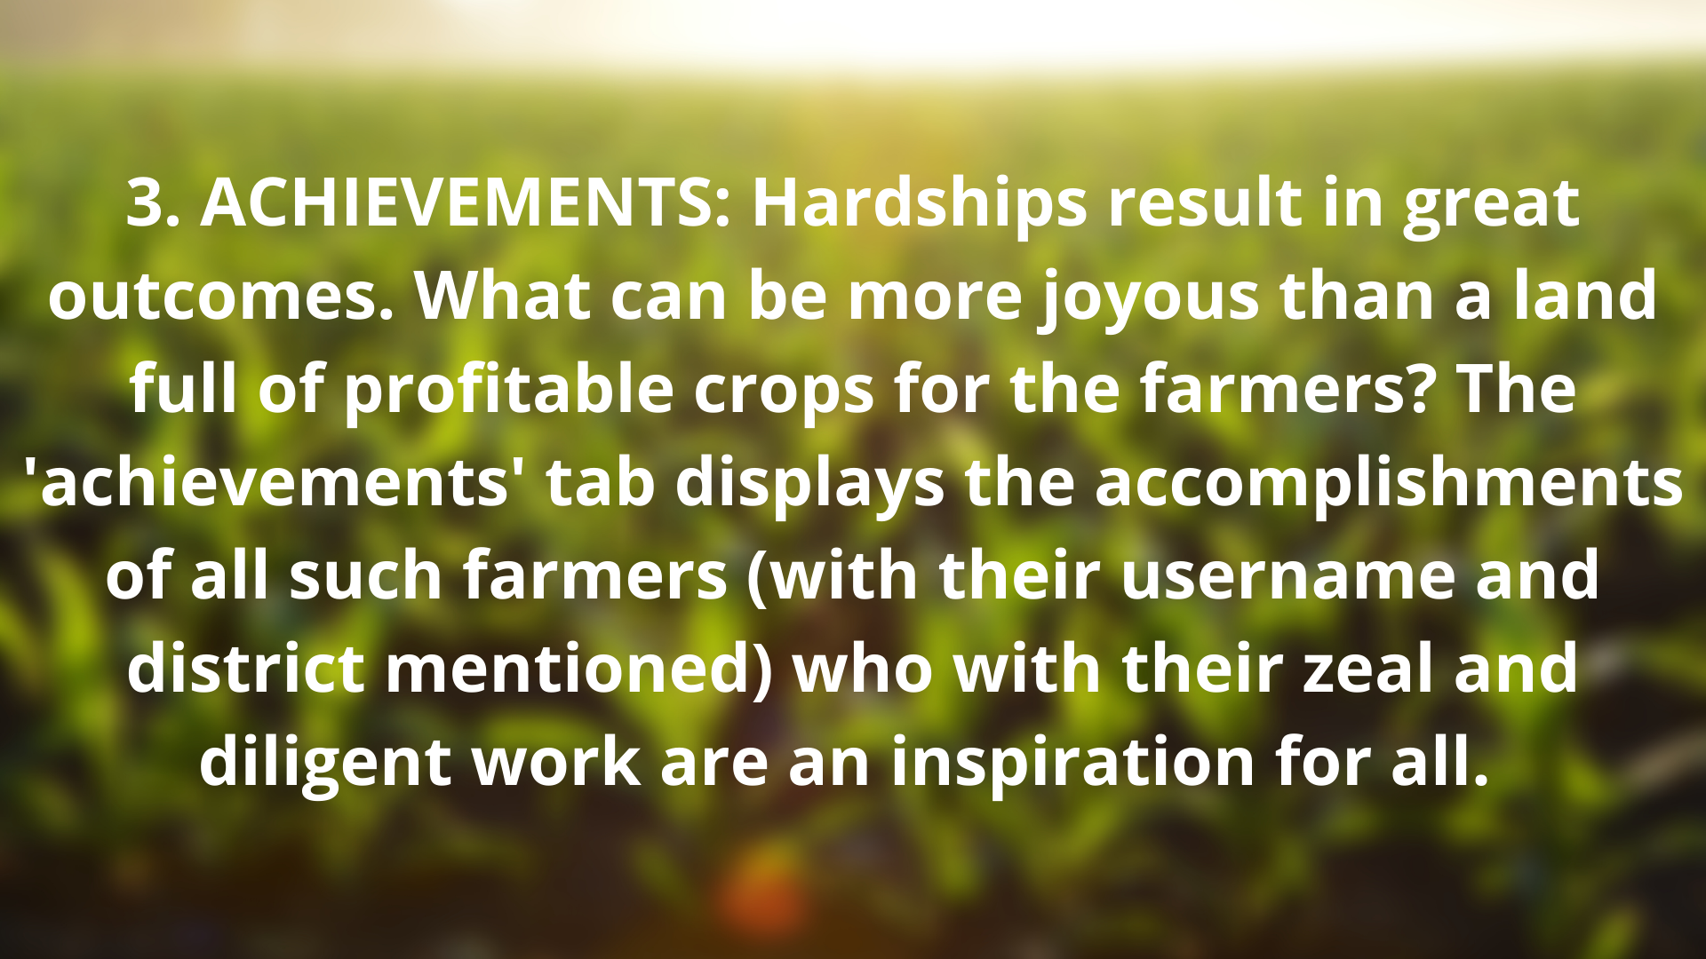

Slide 8
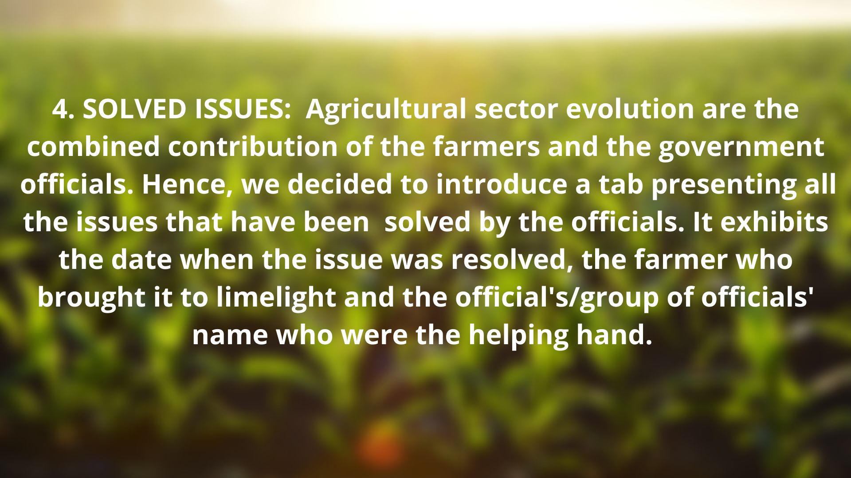

Slide 9
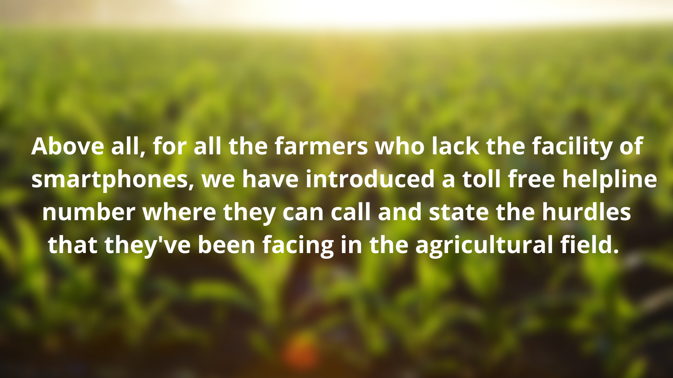
The help centre will create a profile of needy farmers and inform them time to time about the progress in their respective problem.

Slide 10
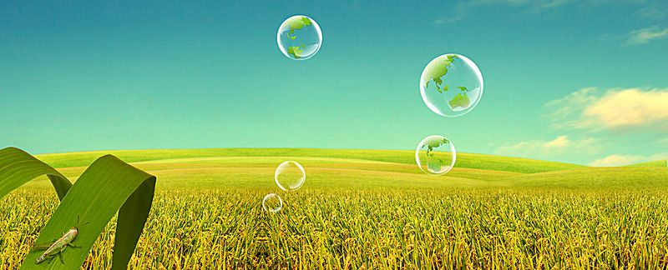
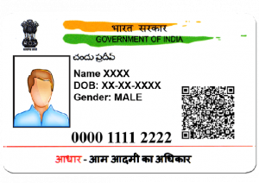

IMPORTANT FEATURES
1. WHILE REGISTRATION WE WILL ASK THE USER TO ENTER THEIR PHONE NO, AADHAR CARD NO AND A NEW PASSWORD
AADHAR CARD NO WILL HELP US FROM THE SAME USER USING DIFFERENT PHONE NO AND CREATING ONE MORE ACCOUNT
THE PROBLEM UPLOADED BY THE FARMERS WILL BE DIRECTLY VISIBLE TO THE OFFICIALS (AGRICULTURE OFFICER AT DISTRICT LEVEL) SO THAT THROUGH THE FUND PROBLEM CAN BE RESOLVED EASILY

Slide 11



3. THERE WILL BE ONE FEATURE OF UPVOTING A MAJOR PROBLEM LIKE IF A FARMER UPLOADS A HIS/HER PROBLEM AND OTHER FARMERS UPVOTE IT AND THUS THAT PARTICULAR PROBLEM WILL BE RESOLVED FIRST
4. GREEN TICK ON THE PROBLEM SOLVED. THIS FEATURE IS TRUSTWORTHY. THERE WILL BE A GREEN TICK ON THAT PROBLEM WHICH HAS BEEN SOLVED. THUS EVERY ONE WILL NOTICE THAT ALL THOSE PROBLEMS ARE BEING CONSIDERED BY THE RESPONSIBLE AUTHORITY OR NOT.

Slide 12
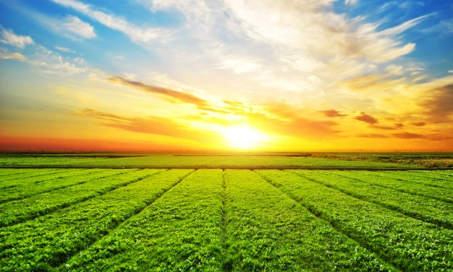


5. TO MAKE AVAILABLE THE CALL CENTRE NO TO THE FARMERS NOT HAVING SMARTPHONE.SO THAT THEY CALL AND THERE PROBLEMS ALSO GET SOLVED. IF THE FARMERS WHO DO NOT HAVE SMARTPHONE AND THEY CALL TO CALL CENTRE THEN THERE ALSO AADHAR NO WILL BE TAKEN TO PROTECT FROM FRAUD CALLS
6. WE WILL UPLAOD TUTORIAL VIDEOS OF ABOUT HOW TO USE THE APP FOR THE FARMERS WHO DO NOT KNOW HOW TO USE AN APP. WE WILL ALSO KEEP UPLOADING VIDEOS IF A NEW FEATURE IS UPLOADED IN APP ,TO LET KNOW THE FARMERS HOW TO USE THE NEW FEATURE UPLOADED

Slide 13
FEATURES THAT WILL BE ADDED AFTER UPGRADATION OF THE APP-
KEEPING LAND RECORDS- Taking matters which mostly happen in some rural area due to land. People can save their land records in their profile verified by district registry office. This will be made essential for every farmers.
SHOWING WEATHER REPORTS- Sometimes there are some irregularities in rainfall pattern. App will show weather report taking agriculture as special view. Which will be a more easy way for them in comparison to other mode of seeing weather report.
DIRECT CONNECTION TO THE MARKET- Few cultivators and farmers grow crops mainly for family consumption due to lack of some resources and other reasons. App will provide a direct connection to the market so that farmers can contact them easily and there will be not any dishonesty in the prices.
GROWTH RATE AND DATA- Agriculture growth rate as well as comparisons from other districts will also be shown at the end of the month.
RECORD OF SURPLUS GRAIN- Record of surplus grain will be kept and the needy persons in different areas will be fulfilled.

Slide 14
BENEFITS:
1.IT IS AN EASY TOOL FOR FARMERS TO USE- The facilities of various tabs and the help line number make it an easy tool that can be in reach of every farmers. The app is specially designed taking in account of farmer's convenience.
2.PROVIDING EMPLOYMENT- The help center will provide employment to the local youths who are not that much well educated but can handle internet related stuffs. Also being locals they have better understanding and sympathy towards farmers and their problems .This in turn stop the youths from choosing an evil path for their survival.

Slide 15
BENEFITS(CONTD.)
3.THE ESSENTIAL ISSUES ARE RESOLVED: The app try to cover almost all the crucial problems faced by farmers and also after upgradation it will cover many more aspects. It will make farmers aware of some innovative ideas of others of their community. It will be much useful in this pandemic and even after that to keep a good data of their produced grains.

